Slide 1
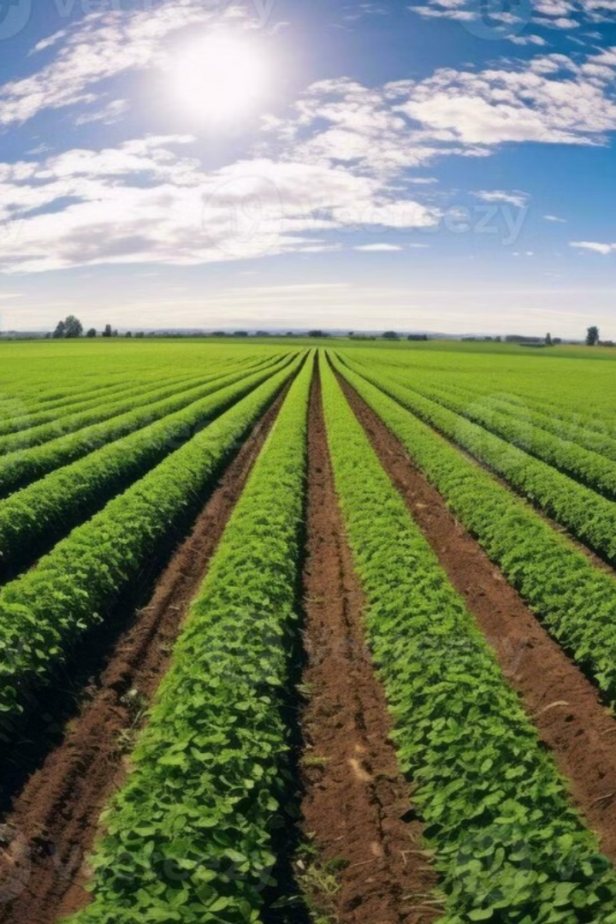
AgroHerb: Empowering Farmers, Connecting Consumers
AgroHerb bridges the gap between natural farmers and health-conscious consumers. Our platform ensures fair prices for farmers and quality for consumers. We foster sustainable agriculture and informed wellness choices through transparency.

Slide 2
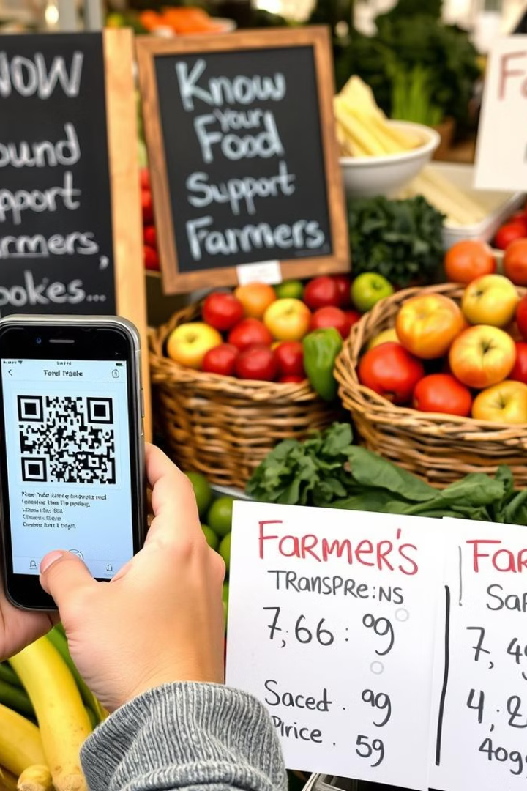



Our Solution: A Transparent Marketplace
Direct Connection
Connect farmers with conscious consumers
QR Code Traceability
Trace origin and farming methods
Fair Pricing
Ensure fair prices through transparency

Slide 3
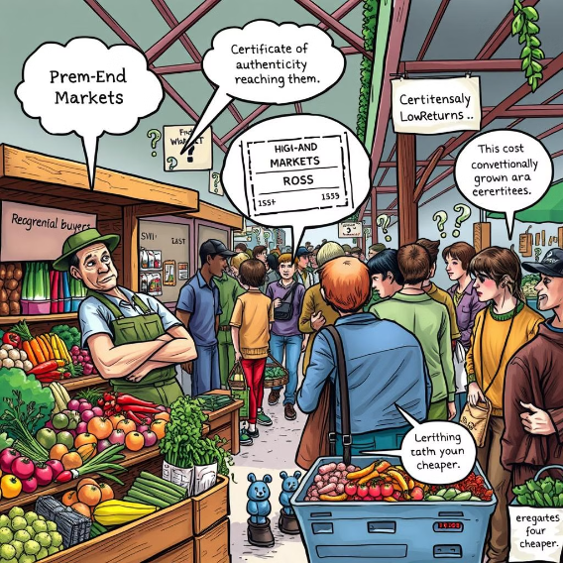
The Problem: Trust and Fair Market Access
Farmers' Challenges
No direct access to premium buyers
Difficulty proving authenticity
High organic farming costs, low returns
Consumers' Challenges
Uncertainty about product authenticity
Limited access to genuine products
Hesitation to pay premiums without proof

Slide 4
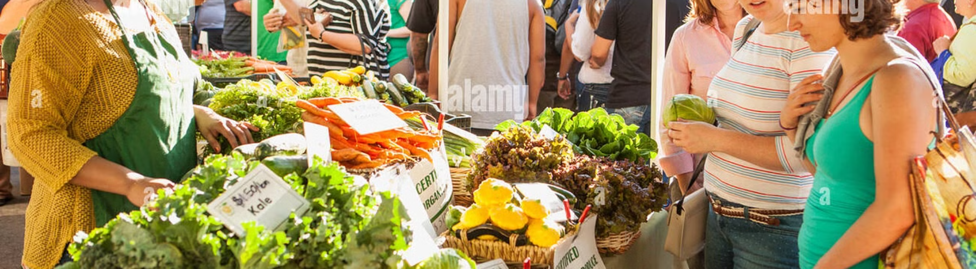




How AgroHerb Works
Farmer Verification
QR Code Generation
Direct Selling
Order Management
Inspection and certification process
Unique codes linking to product details
Consumers purchase directly from farmers
Easy ordering, payments, and delivery

Slide 5
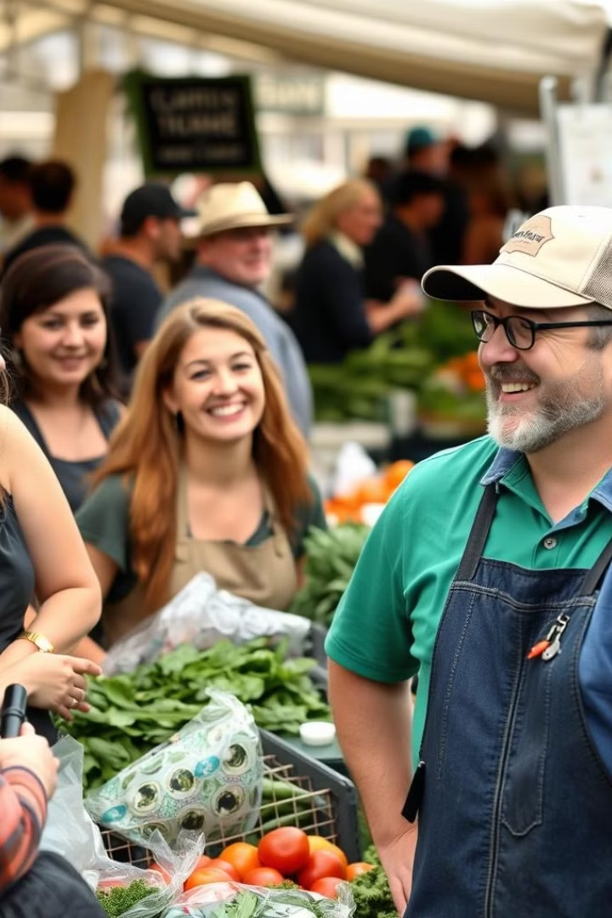
Target Audience: Who Benefits?
Farmers
Consumers
Small to mid-sized natural farmers
Health-conscious buyers
Herbal Experts
Businesses needing certified organic produce

Slide 6
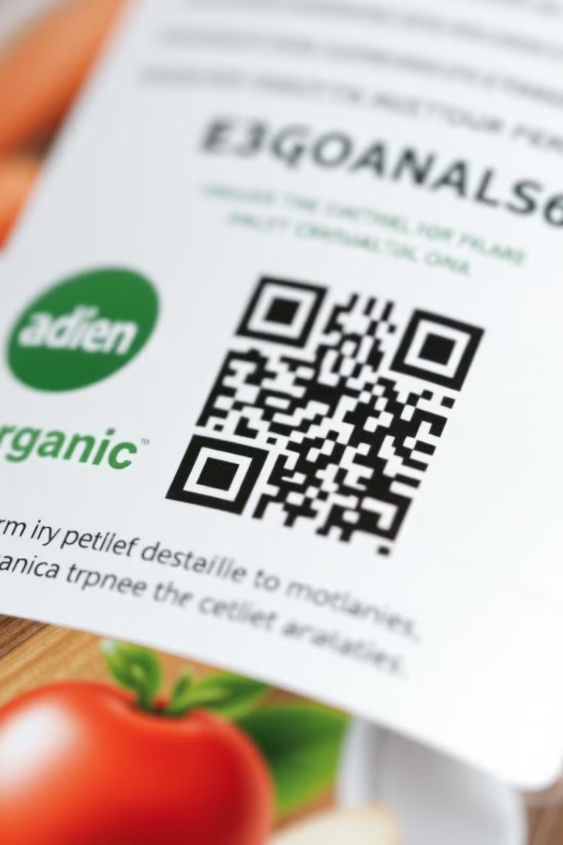



What Makes Us Unique?
Elimination of Middlemen
Real-Time Traceability
Rigorous Certification Process

Slide 7
Technology Stack
Frontend: React
Backend: Django
Dynamic user interface
Secure data storage
Product browsing
API endpoints
User account management
User authentication
Interactive maps
Scalable foundation

Slide 8

Building a Trusted Organic Marketplace
AgroHerb creates a farmer-friendly, consumer-trusted marketplace. We solve problems of trust, traceability, and fair pricing.
We envision empowered farmers and confident consumers. Through transparency, we redefine the organic market.
We promise quality, integrity, and a healthier future.

